Slide 1
Introduction to cell biology and single-cell RNA sequencing
Work experience – July 2025

Slide 2
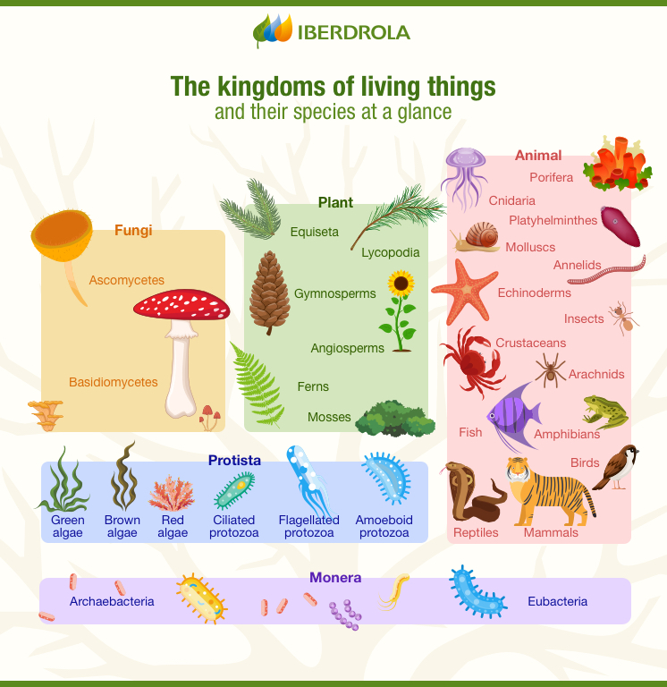
Multicellular organisms
Plants, animals and fungi are made many individual cells
A human body comprises ~37 trillion cells
Most animals begin life as a single fertilized egg
Cells divide, giving rise to new cells.
Most cells specialize eg. Skin cells, blood cells, muscle cells, neurons…
https://www.iberdrola.com/sustainability/biology-kingdoms-living-things-classification

Slide 3
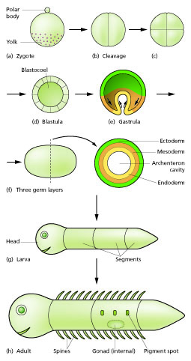
Development from one cell to many cells
Development from a fertilized egg cell to an adult animal seems complex and is an area of research
There is a cascade of steps where cells differentiate into simpler tissues and then into more complex tissues
https://en.wikipedia.org/wiki/Developmental_biology

Slide 4
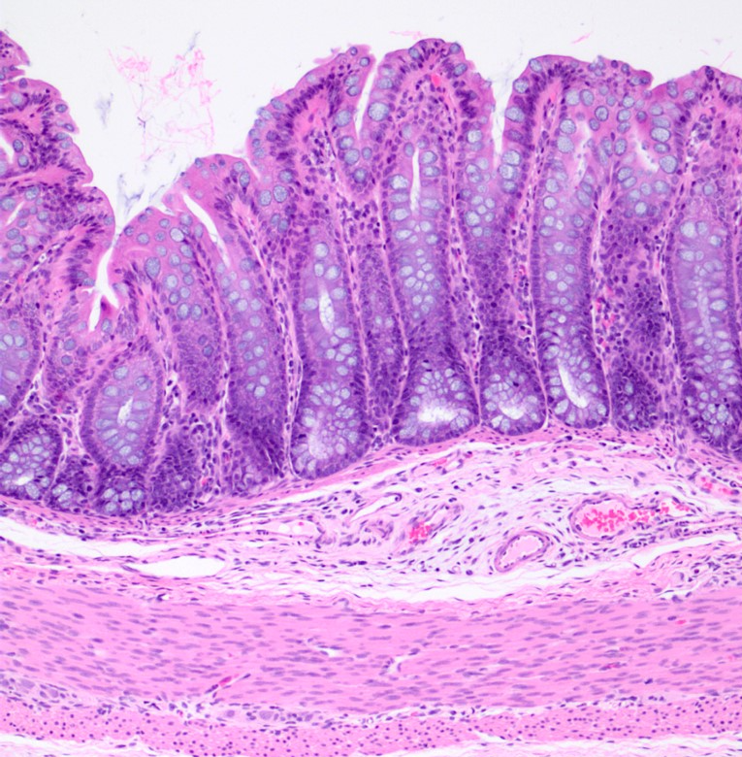
Organization of tissues
Healthy tissues are highly ordered
Tissues are made of different types of specialized cells
https://ohiostate.pressbooks.pub/vethisto/chapter/8-general-histologic-anatomy-of-the-tubular-digestive-tract/

Slide 5
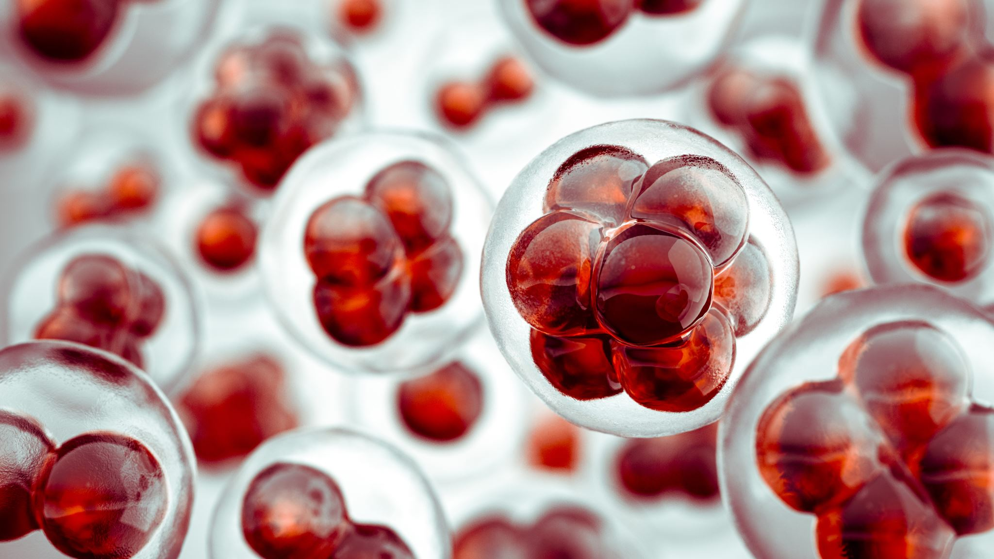
What makes cells different?

Slide 6
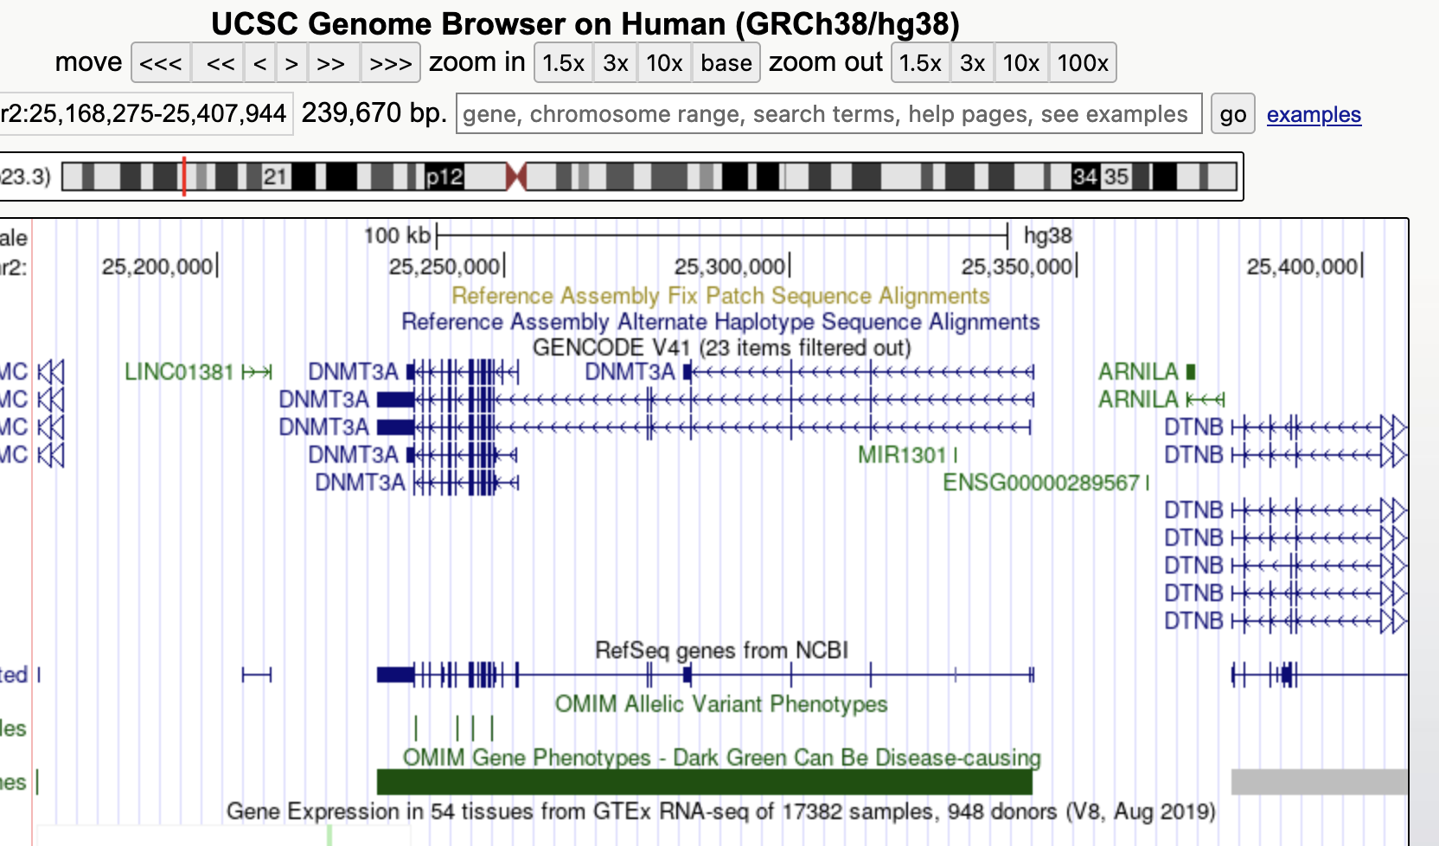
Gene expression
Genes are regions of DNA
Genes are transcribed to produce RNA by the enzyme ‘RNA polymerase’
We call this process ‘gene expression’
RNAs can be used by ribosomes to translate proteins

Slide 7
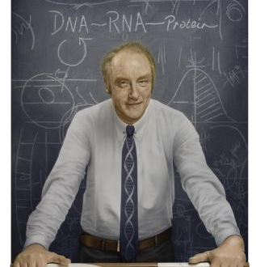
The Central Dogma
DNA can self-replicate
RNA molecules are transcribed from regions of DNA called genes
There are different RNAs in cells that perform different tasks
Messenger RNAs encode the sequences of proteins
Proteins are little molecular machines that can perform tasks inside cells

Slide 8
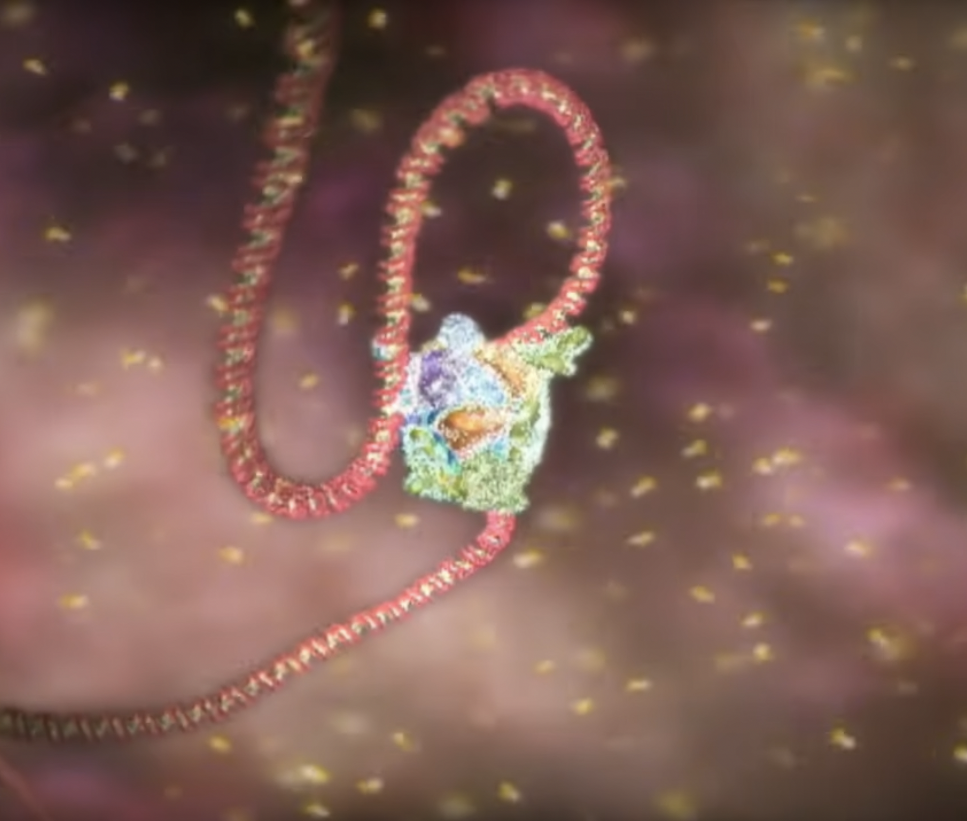
The Central Dogma
Watch the YouTube video: https://www.youtube.com/watch?v=9kOGOY7vthk

Slide 9
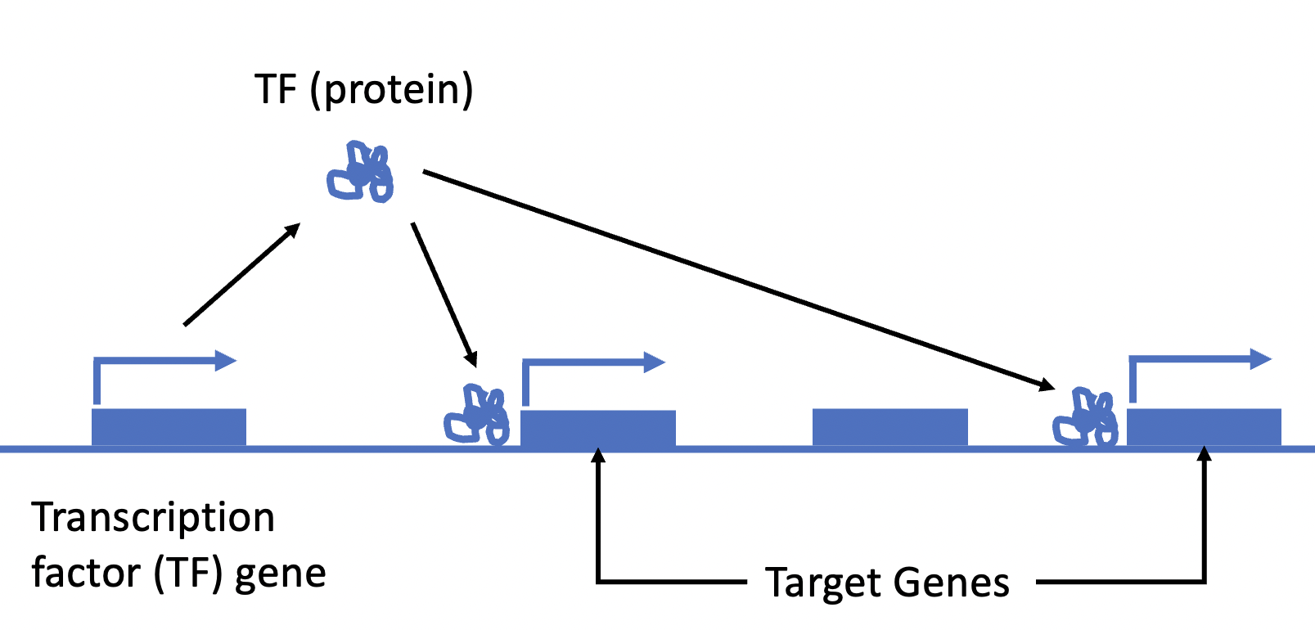
How is gene expression controlled?
Some genes encode proteins called Transcription Factors (TF)
TFs recognize and bind DNA sequences (promotors) in front of other, specific genes
TFs bind promoters and enable the binding of other proteins
These other proteins transcribe the messenger RNAs from the target genes

Slide 10
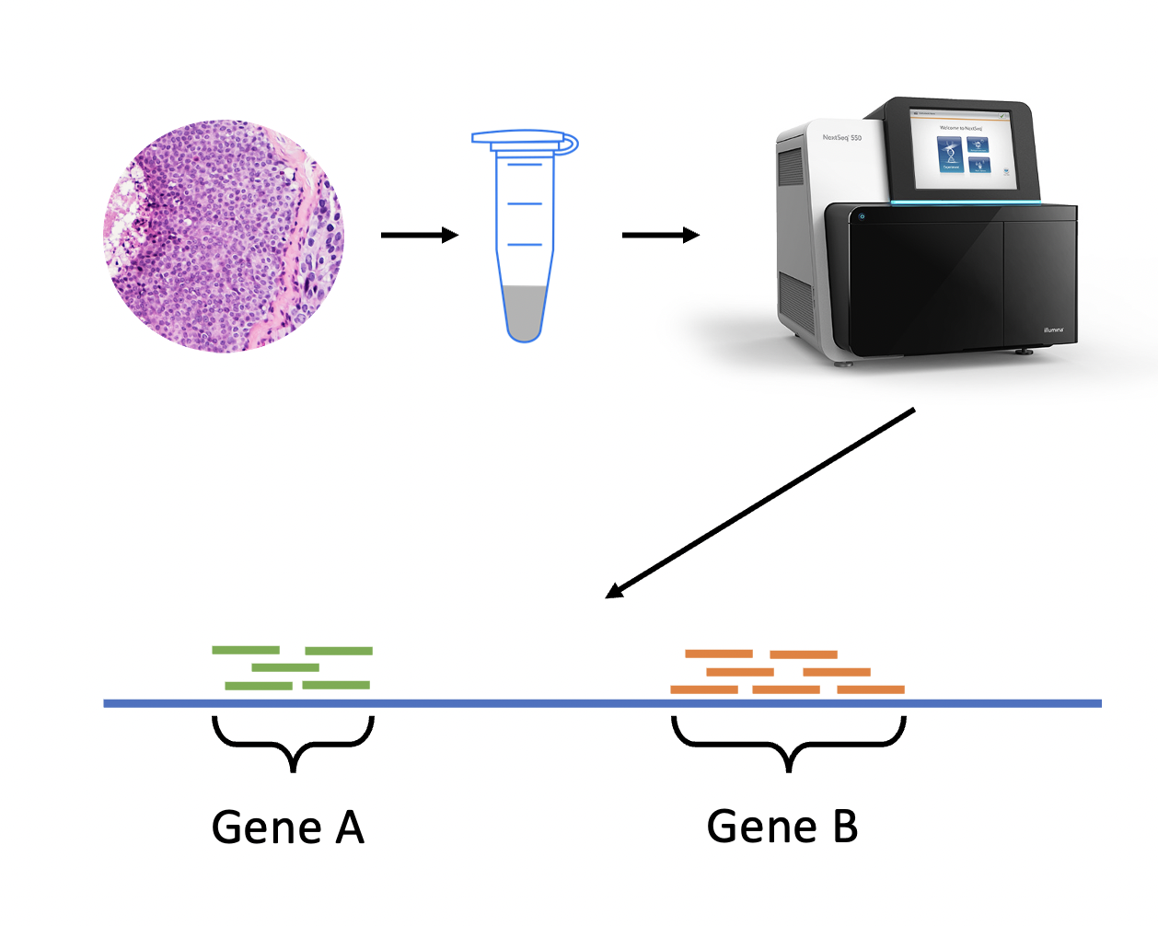
How can we study gene expression?
Take a sample of tissue
Extract the RNA
Convert the RNA to complementary DNA (cDNA) library
Determine the order of bases (A,T,C,G) in the cDNA fragments using a sequencer
Align the sequences to a reference genome sequence
Count the reads matching to each gene – the more reads that are counted, the more that gene was expressed

Slide 11
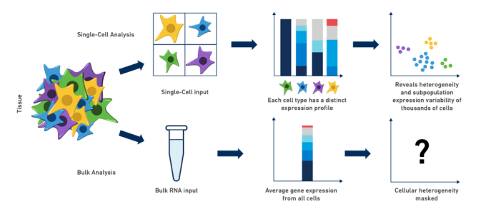
Single-cell vs bulk RNA-Seq
With bulk RNA-Seq, we measure gene expression in a mixture of cells
With single-cell RNA-Seq, we can measure gene expression in individual cells
This allows us to study individual cells derived from a tissue
https://www.10xgenomics.com/blog/single-cell-rna-seq-an-introductory-overview-and-tools-for-getting-started

Slide 12
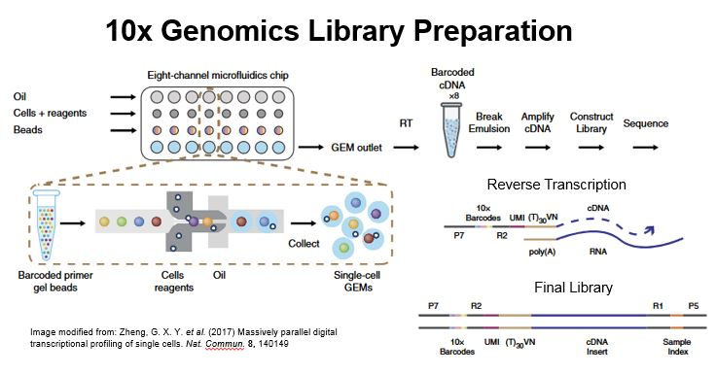

Slide 13
Single-cell RNA-Seq workflow
Load counts matrix
QC (identify dying cells and doublets)
Remove problem cells
Normalise counts
Identify marker genes
Identify cell types
Identify variable genes
Cluster cells
Dimension reduction (UMAP)
Dimension reduction (PCA)
Scale counts

Slide 14
The plan…
Set up laptops with Linux, Python, Conda and Scanpy
Copy an example analysis looking at 2700 white blood cells
Analyse a new data set of mouse embryonic cells
Use cell atlas databases to identify mouse embryo cell types (we haven’t done this before)

